Slide 1
INNER CLASSES & GENERIC

Slide 2
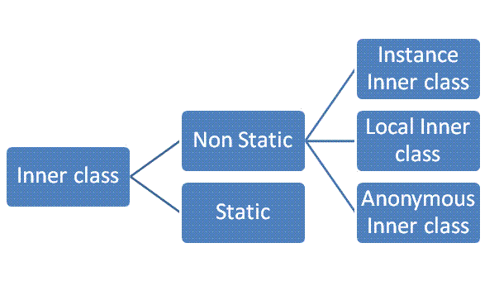

Slide 3
NESTED INNER CLASS
It can access any private instance variable of outer class
It can have access modifier private, protected, public and default modifier.
ANONYMOUS INNER CLASS
Anonymous inner classes are declared without any name
a) As subclass of specified type
b) As implementer of the specified interface

Slide 4
STATIC NESTED CLASSES
They are like a static member of outer class.
METHOD LOCAL INNER CLASSES
Inner class can be declared within a method of an outer class
It can’t use local variable of outer method until that local variable is not declared as final
Local inner class cannot access non-final local variable till JDK 1.7. from JDK 1.8, it is possible.

Slide 5
GENERICS IN JAVA
Java 5
Avoid compile-time type checking and removes ClassCastException that was common in collection classes
collection framework was re-written to use generics for type-safety
GENERIC CLASS OR INTERFACE
It is parameterized over types
Angle brackets (<>) to specify the type parameter.
If type is not provided - type becomes Object (allowing both String and Integer objects)

Slide 6
EXAMPLES

